Slide 1

CEC 2024 Competition on
Multiparty Multiobjective Optimization
Wenjian Luo¹, Peilan Xu², Shengxiang Yang³, Yuhui Shi⁴
² Harbin Institute of Technology, Shenzhen,
² Nanjing University of Information Sciences and Technology
³ The De Montfort University
⁴ Southern University of Science and Technology

Slide 2
Outline
Introduction
Benchmarks
Experiment Settings
Results
Notes:
Our presentation mainly focuses on the four parts, Introduction，the benchmarks, experiment settings and the results. First, I will introduce the dynamic multimodal optimization problems.

Slide 3
Multiparty Multiobjective Optimization Problem (MPMOP)
  Multiparty Multiobjective Optimization Problem (MPMOP) is a class of multiobjective optimization problems (MOP), which involve multiple decision-makers (DMs).
  Challenge: MPMOP are often regarded as general MOPs, wherein the optimization objectives of various decision-makers are collected, and multiple decision-makers are considered as a single role.
* Wenjian Luo, Peilan Xu, Shengxiang Yang, and Yuhui Shi. Benchmark for CEC 2024 Competition on Multiparty Multiobjective Optimization. arXiv preprint arXiv:2402.02033, 2024.

Slide 4

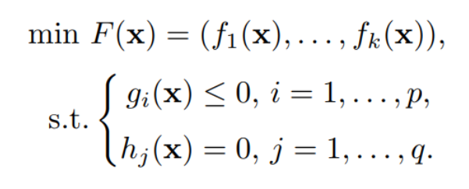

Definitions of DMMOPs
  Definitions:
  $x=(x_{1},…,x_{n})$denotes the decision vector.
  $\left(f_{1},…,f_{k}\right),\left(g_{1},…,g_{p}\right),\left(h_{1},…,h_{q}\right)$ represents the objective functions, inequality and equality constraint functions
  For $x^{∗}$to meet the criteria of being the best solution, we have the following two conditions:
    For all parties involved, either $x ≺ x^{∗}$or they are nondominated by each other, indicating mutual nondominance.
    For at least one party, $x ≺ x^{∗}$, signifying that x is dominated by x∗ for that specific party’s objectives.

Slide 5
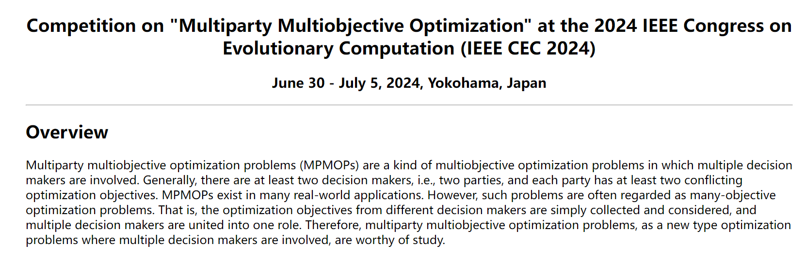

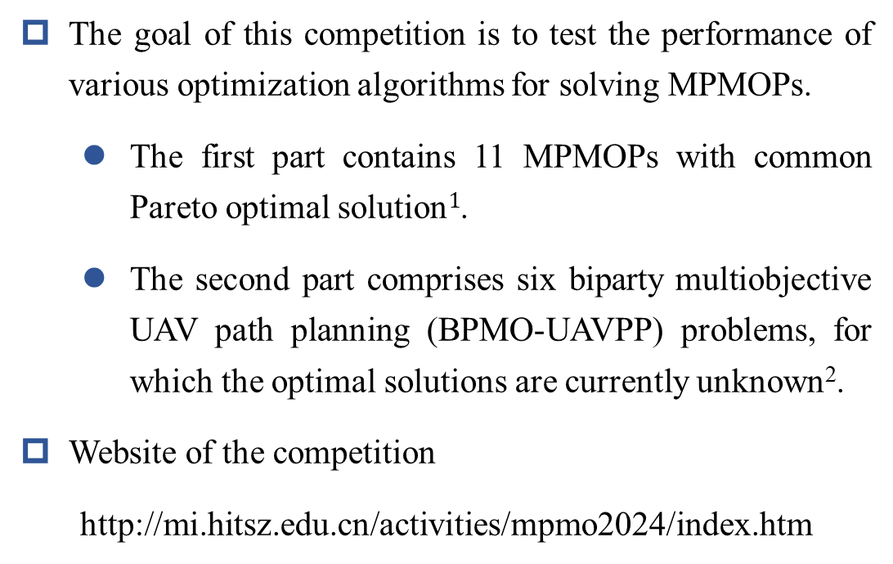
Competition on MPMOPs
  The goal of this competition is to test the performance of various optimization algorithms for solving MPMOPs.
    The first part contains 11 MPMOPs with common Pareto optimal solution$1$.
    The second part comprises six biparty multiobjective UAV path planning (BPMO-UAVPP) problems, for which the optimal solutions are currently unknown².
  Website of the competition
  http://mi.hitsz.edu.cn/activities/mpmo2024/index.htm
[1] W. Liu, W. Luo, X. Lin, M. Li, and S. Yang, Evolutionary approach to multiparty multiobjective optimization problems with common pareto optimal solutions," in 2020 IEEE Congress on Evolutionary Computation (CEC). IEEE, 2020, pp. 1-9.
[2] K. Chen, W. Luo, X. Lin, Z. Song, and C. Yatong, Evolutionary biparty multiobjective UAV path planning: Problems and empirical comparisons," IEEE Transactions on Emerging Topics in Computational Intelligence, 2023.
Notes:
So, we have held a competition to explore the performance of the optimization algorithms for solving dynamic multimodal optimization problems. The benchmarks are from our previous work, mainly focusing on various cases of the dynamic and multimodal properties, respectively.

Slide 6
Outline
Introduction
Benchmarks
Experiment Settings
Results
Notes:
Next, I will introduce the benchmarks adopted in the competition.

Slide 7
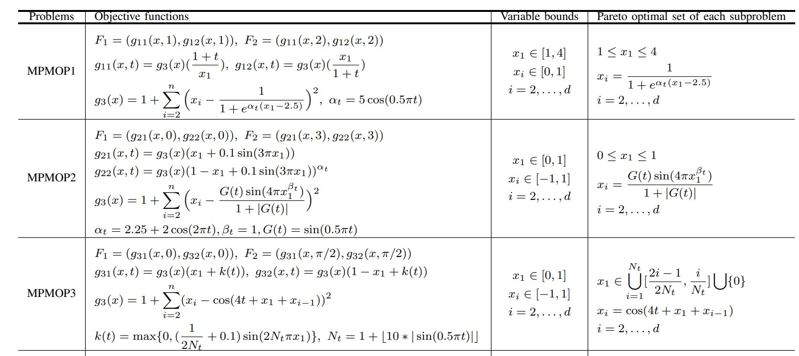
MPMOPs with Common Pareto Optimal Solutions
* W. Liu, W. Luo, X. Lin, M. Li, and S. Yang, Evolutionary approach to multiparty multiobjective optimization problems with common pareto optimal solutions," in 2020 IEEE Congress on Evolutionary Computation (CEC). IEEE, 2020, pp. 1-9.
Notes:
The next one is the dynamic property. Here, six popular changes are adopted in our benchmarks. Small step, large step, random change, chaotic change,recurrent change …

Slide 8
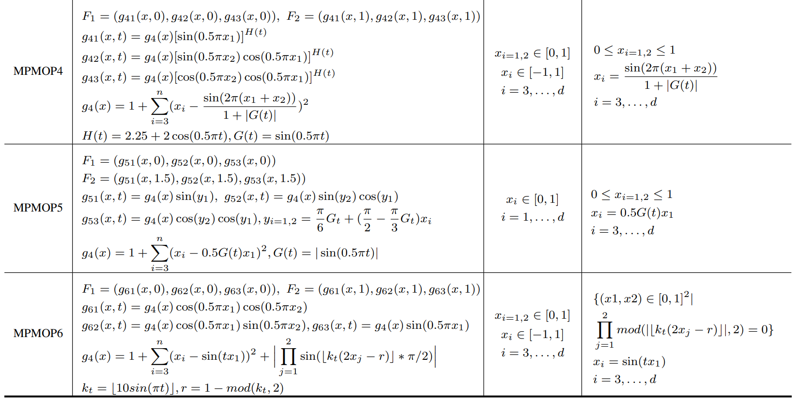
MPMOPs with Common Pareto Optimal Solutions
* W. Liu, W. Luo, X. Lin, M. Li, and S. Yang, Evolutionary approach to multiparty multiobjective optimization problems with common pareto optimal solutions," in 2020 IEEE Congress on Evolutionary Computation (CEC). IEEE, 2020, pp. 1-9.
Notes:
The next one is the dynamic property. Here, six popular changes are adopted in our benchmarks. Small step, large step, random change, chaotic change,recurrent change …

Slide 9
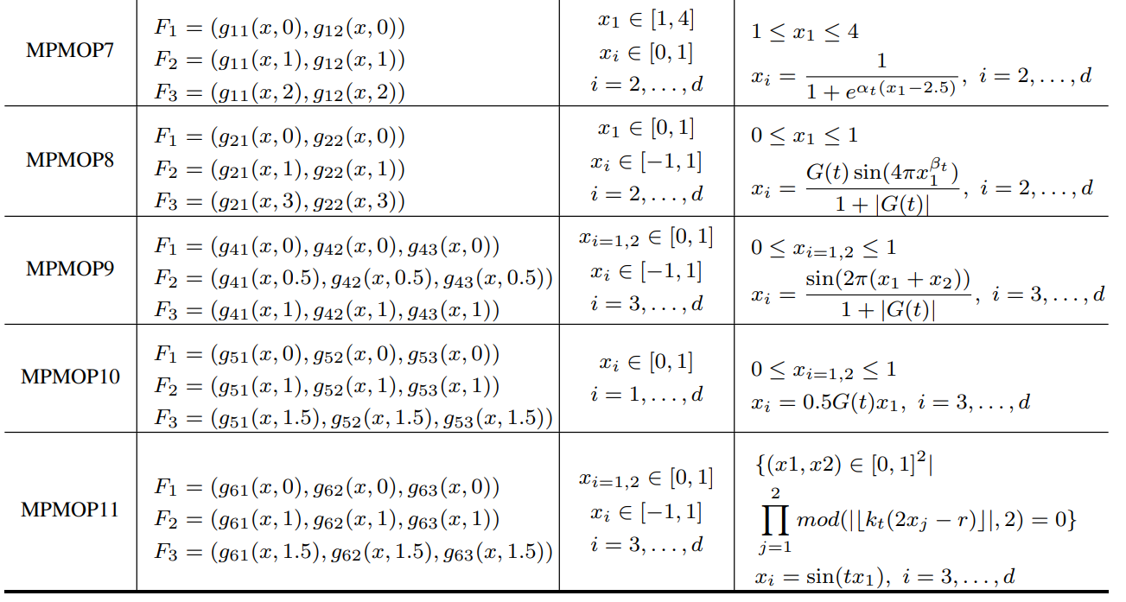
MPMOPs with Common Pareto Optimal Solutions
* W. Liu, W. Luo, X. Lin, M. Li, and S. Yang, Evolutionary approach to multiparty multiobjective optimization problems with common pareto optimal solutions," in 2020 IEEE Congress on Evolutionary Computation (CEC). IEEE, 2020, pp. 1-9.
Notes:
The next one is the dynamic property. Here, six popular changes are adopted in our benchmarks. Small step, large step, random change, chaotic change,recurrent change …

Slide 10
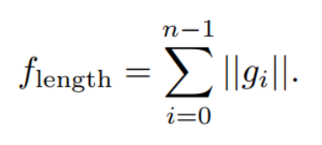
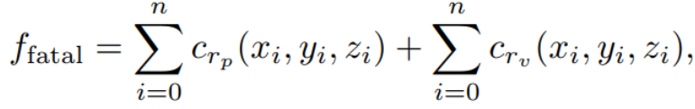
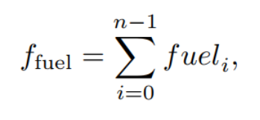
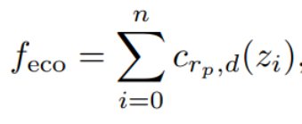
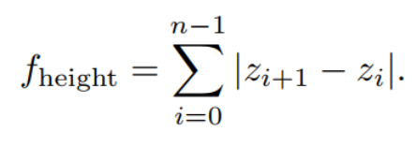
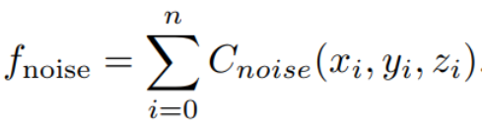
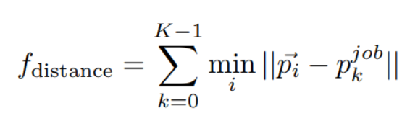
Biparty Multi-objective UAV Path Planning
  Efficiency Decision-Maker:
    Path Length:
    Flight energy consumption:
    Path height changes:
    Mission hover point distance
  Efficiency Decision-Maker:
    Fatality Risks:
    Property Risk:
    Noise Pollution:
* K. Chen, W. Luo, X. Lin, Z. Song, and C. Yatong, Evolutionary biparty multiobjective UAV path planning: Problems and empirical comparisons," IEEE Transactions on Emerging Topics in Computational Intelligence, 2023.
Notes:
The next one is the dynamic property. Here, six popular changes are adopted in our benchmarks. Small step, large step, random change, chaotic change,recurrent change …

Slide 11
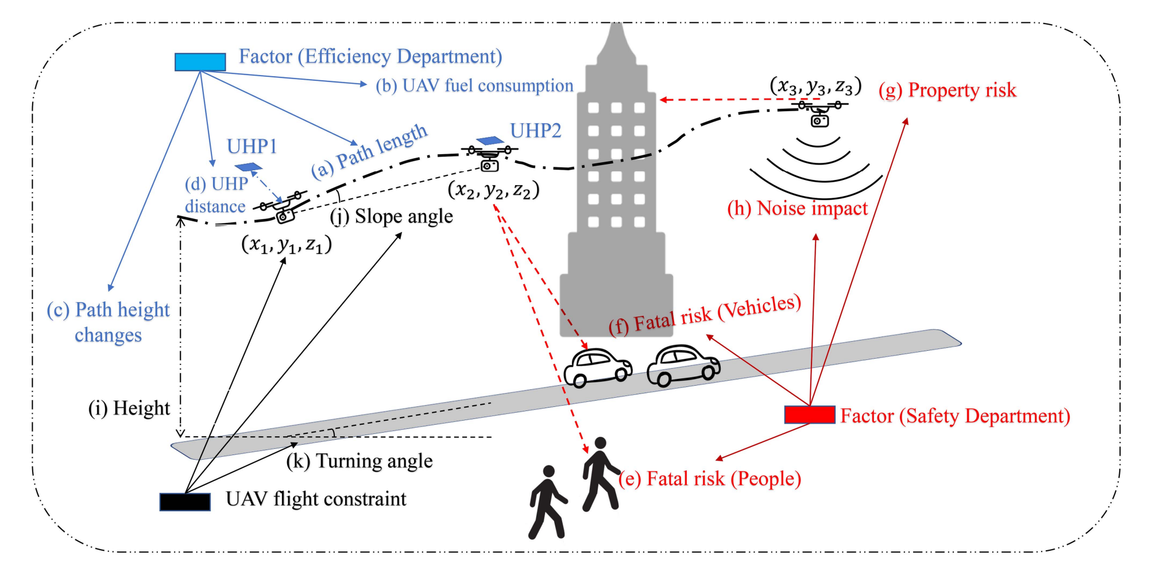
Biparty Multi-objective UAV Path Planning
Objectives and constraints of the UAV path planning problem from the perspective of the BPMOP. (a)-(d), which are marked in blue, are the objectives of the efficiency department. (e)-(h), which are marked in red, are the objectives of the safety department. (i)-(k), which are marked in black, are the constraints of the UAV.
Notes:
The next one is the dynamic property. Here, six popular changes are adopted in our benchmarks. Small step, large step, random change, chaotic change,recurrent change …

Slide 12
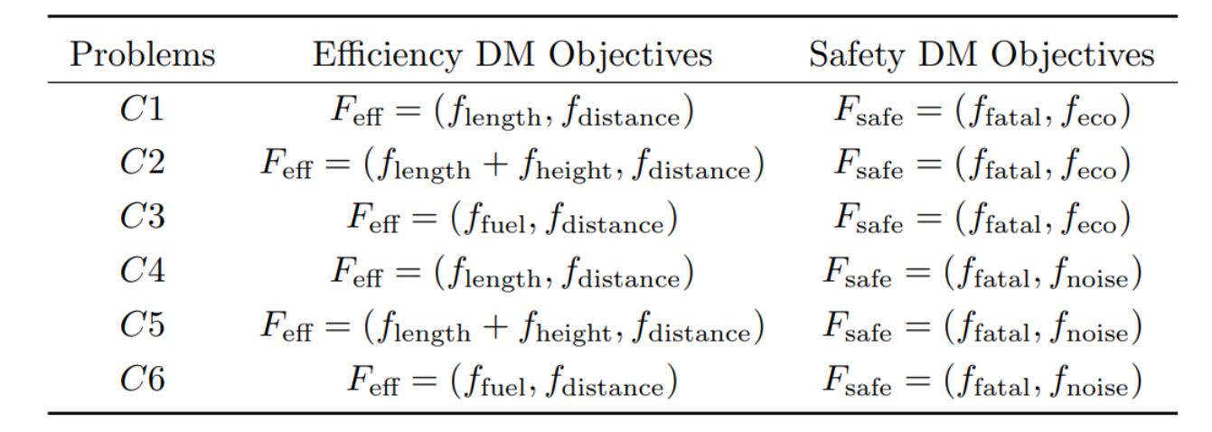
Biparty Multi-objective UAV Path Planning
Details of the Test Case
Notes:
The next one is the dynamic property. Here, six popular changes are adopted in our benchmarks. Small step, large step, random change, chaotic change,recurrent change …

Slide 13
Others
  Information of Benchmark s
    Dimension: The dimensions of the decision variables for the first set of benchmark suites include 10, 30, 50.
    Runs: 30. The random seeds of all runs should be fixed from 1 to 30.
    Maximum Fitness evaluations: the maximum fitness evaluations of the first set of benchmark suites is set to 1000 · D · M, and the second set of benchmark suites is set to 100000.
    Termination condition: all the fitness evaluations are consumed.
Notes:
It is noted that there are other move conditions to ensure there exist a minimum distance between each peaks in each environment. If the movement breaks the rule, the unsatisfied peaks will move multiple time until the condition is satisfied.

Slide 14
Outline
Introduction
Benchmarks
Experiment Settings
Results
Notes:
The third part is the experiment settings.

Slide 15
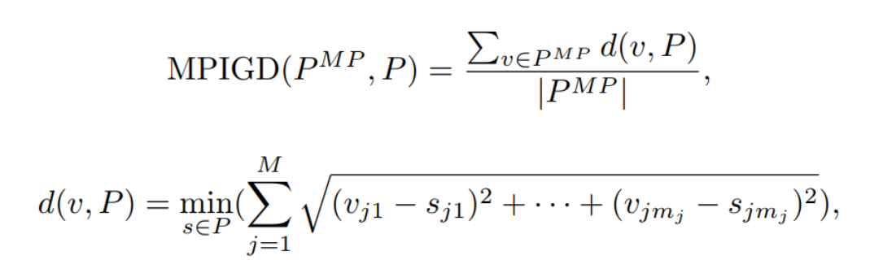
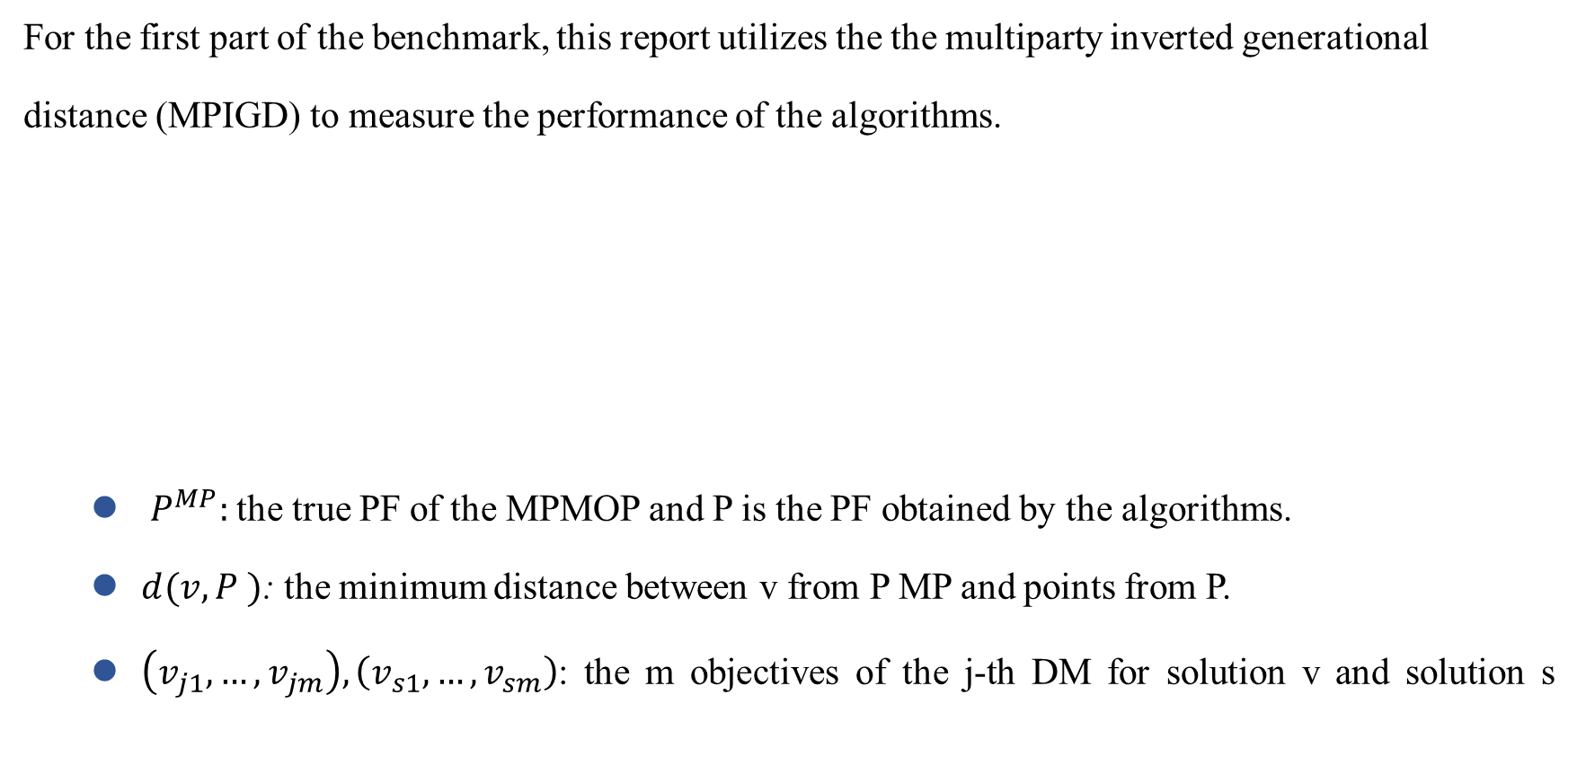
Performance Metric
  For the first part of the benchmark, this report utilizes the the multiparty inverted generational
  distance (MPIGD) to measure the performance of the algorithms.
    $P^{MP}:$the true PF of the MPMOP and P is the PF obtained by the algorithms.
    $d(v, P )$: the minimum distance between v from P MP and points from P.
    $\left(v_{j1},…, v_{jm}\right),\left(v_{s1},…, v_{sm}\right)$: the m objectives of the j-th DM for solution v and solution s
Notes:
The performance is measured by the peak ratio indicator. That is, for each environment, the number of found optimal solutions are obtained and the peak ratio value is obtained. The larger the value, the more powerful performance of the algorithms.

Slide 16
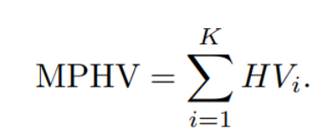

Performance Metric
  For the second part of the benchmark, this report utilizes the multiparty hypervolume (MPHV) metric, derived from the hypervolume (HV) metric.
      $HV_{i}:$ the HV metric of the solution set regarding the objectives of the i-th decision maker.
Notes:
The performance is measured by the peak ratio indicator. That is, for each environment, the number of found optimal solutions are obtained and the peak ratio value is obtained. The larger the value, the more powerful performance of the algorithms.

Slide 17
Outline
Introduction
Benchmarks
Experiment Settings
Results
Notes:
The last part is the competition results, we will publish these data in the next few days.

Slide 18
Algorithms
Name | Authors
Dimension-based Algorithm Selector（DBAS） | Mingyin Zou, Xiaomin Zhu, Guangrong You
BBMPGA | Shaopeng Zhang, Xin Lin
Notes:
During the competition, we have received eight results. These algorithms are based on the popular evolutionary algorithms and swarm intelligence, such as differential evolution, particle swarm optimization, evolutionary strategy and so on.

Slide 19
Results
 |  |  | E1 | E2 | E3 | E4 | E5 | E6 | E7 | E8 | E9 | E10 | E11
d=10 | DBAS | Best | 2.06E-05 | 3.55E-05 | 1.70E-02 | 4.49E-02 | 4.89E-02 | 1.09E-02 | 1.82E-05 | 1.05E-04 | 3.22E-01 | 4.95E-01 | 2.24E-01
 |  | Median | 5.14E-05 | 2.55E-04 | 4.25E-02 | 5.92E-02 | 6.31E-02 | 1.90E-02 | 5.60E-05 | 1.92E-04 | 6.03E-01 | 1.24E+00 | 1.19E+00
 |  | Worst | 1.49E-04 | 1.67E-01 | 1.85E-01 | 9.24E-02 | 9.96E-02 | 2.39E-02 | 1.01E-04 | 2.51E-01 | 1.29E+00 | 1.42E+00 | 2.38E+00
 |  | Mean | 5.62E-05 | 8.23E-03 | 5.50E-02 | 6.15E-02 | 6.63E-02 | 1.79E-02 | 5.34E-05 | 1.69E-02 | 6.18E-01 | 1.13E+00 | 1.53E+00
 |  | StDev | 2.77E-05 | 3.27E-02 | 3.82E-02 | 1.08E-02 | 1.36E-02 | 3.68E-03 | 2.28E-05 | 6.36E-02 | 1.79E-01 | 2.96E-01 | 5.99E-01
 | BBMPGA | Best | 5.58E-06 | 1.07E-05 | 8.89E-03 | 3.60E-02 | 4.11E-02 | 8.82E-03 | 8.75E-07 | 4.14E-06 | 5.22E-02 | 4.13E-02 | 1.19E-02
 |  | Medium | 1.55E-05 | 6.61E-05 | 1.85E-02 | 4.67E-02 | 6.32E-02 | 1.57E-02 | 4.47E-06 | 1.43E-05 | 6.32E-02 | 5.27E-02 | 1.30E-02
 |  | Worst | 3.97E-05 | 1.67E-01 | 5.12E-02 | 5.95E-02 | 1.30E-01 | 1.93E-02 | 2.01E-05 | 4.01E-02 | 7.41E-02 | 6.80E-02 | 1.51E-02
 |  | Mean | 1.64E-05 | 5.64E-03 | 2.25E-02 | 4.72E-02 | 6.67E-02 | 1.48E-02 | 5.61E-06 | 1.36E-03 | 6.42E-02 | 5.21E-02 | 1.32E-02
 |  | DevStd | 7.09E-06 | 3.05E-02 | 1.04E-02 | 5.02E-03 | 1.65E-02 | 2.81E-03 | 4.02E-06 | 7.31E-03 | 5.54E-03 | 6.42E-03 | 8.36E-04
d=30 | DBAS | Best | 3.37E-04 | 1.33E-03 | 2.46E-01 | 1.32E-01 | 8.80E-02 | 5.11E-02 | 4.25E-04 | 1.40E-03 | 5.99E-01 | 3.39E-01 | 1.16E+00
 |  | Median | 7.91E-04 | 3.44E-03 | 5.31E-01 | 1.71E-01 | 1.73E-01 | 8.52E-02 | 8.64E-04 | 3.77E-03 | 8.34E-01 | 1.21E+00 | 2.32E+00
 |  | Worst | 6.84E-03 | 1.71E-01 | 9.11E-01 | 3.70E-01 | 1.01E+00 | 1.14E-01 | 1.65E-03 | 2.54E-01 | 1.97E+00 | 7.02E+00 | 4.03E+00
 |  | Mean | 9.82E-04 | 2.92E-02 | 5.40E-01 | 1.83E-01 | 2.77E-01 | 8.17E-02 | 8.94E-04 | 5.66E-02 | 9.87E-01 | 1.58E+00 | 2.39E+00
 |  | StDev | 1.13E-03 | 5.35E-02 | 1.37E-01 | 4.87E-02 | 2.51E-01 | 1.82E-02 | 2.88E-04 | 8.18E-02 | 4.18E-01 | 1.46E+00 | 8.85E-01
 | BBMPGA | Best | 5.89E-06 | 1.38E-05 | 9.95E-02 | 3.28E-02 | 3.25E-02 | 1.08E-02 | 3.37E-06 | 3.78E-06 | 4.58E-02 | 2.25E-02 | 1.08E-02
 |  | Medium | 1.46E-05 | 3.05E-05 | 1.85E-01 | 3.85E-02 | 3.81E-02 | 1.21E-02 | 6.10E-06 | 9.41E-06 | 5.30E-02 | 2.97E-02 | 1.21E-02
 |  | Worst | 2.64E-05 | 1.68E-01 | 6.12E-01 | 6.59E-02 | 4.52E-02 | 1.34E-02 | 2.24E-05 | 6.38E-03 | 7.31E-02 | 3.82E-02 | 1.40E-02
 |  | Mean | 1.50E-05 | 1.60E-02 | 2.05E-01 | 3.98E-02 | 3.87E-02 | 1.20E-02 | 6.72E-06 | 2.32E-04 | 5.45E-02 | 2.96E-02 | 1.22E-02
 |  | DevStd | 4.71E-06 | 4.50E-02 | 1.08E-01 | 6.64E-03 | 3.33E-03 | 6.95E-04 | 3.88E-06 | 1.16E-03 | 6.01E-03 | 2.70E-03 | 6.68E-04
d=50 | DBAS | Best | 5.66E-03 | 1.82E-02 | 7.78E-01 | 1.95E-01 | 2.28E-01 | 8.64E-02 | 6.48E-03 | 1.93E-02 | 6.17E-01 | 4.35E-01 | 2.27E+00
 |  | Median | 8.45E-03 | 3.95E-02 | 1.40E+00 | 3.01E-01 | 2.05E+00 | 1.16E-01 | 1.10E-02 | 9.78E-02 | 9.19E-01 | 1.09E+00 | 5.14E+00
 |  | Worst | 2.68E-02 | 2.66E-01 | 2.27E+00 | 4.66E-01 | 5.16E+00 | 1.70E-01 | 2.33E-02 | 3.08E-01 | 2.62E+00 | 3.84E+00 | 9.31E+00
 |  | Mean | 9.85E-03 | 8.96E-02 | 1.45E+00 | 3.07E-01 | 2.10E+00 | 1.22E-01 | 1.22E-02 | 1.45E-01 | 9.83E-01 | 1.45E+00 | 5.28E+00
 |  | StDev | 4.71E-03 | 7.90E-02 | 3.61E-01 | 7.12E-02 | 1.08E+00 | 2.05E-02 | 4.79E-03 | 1.20E-01 | 3.91E-01 | 9.23E-01 | 1.41E+00
 | BBMPGA | Best | 8.22E-06 | 2.35E-05 | 2.05E-01 | 2.98E-02 | 2.31E-02 | 9.76E-03 | 3.70E-06 | 9.00E-06 | 4.34E-02 | 1.92E-02 | 1.13E-02
 |  | Medium | 1.43E-05 | 3.38E-05 | 5.39E-01 | 3.75E-02 | 2.79E-02 | 1.08E-02 | 8.56E-06 | 1.89E-05 | 5.45E-02 | 2.24E-02 | 1.21E-02
 |  | Worst | 2.55E-05 | 3.23E-03 | 7.69E-01 | 9.05E-02 | 3.23E-02 | 1.22E-02 | 1.38E-05 | 1.14E-04 | 8.59E-02 | 2.59E-02 | 1.39E-02
 |  | Mean | 1.49E-05 | 1.47E-04 | 5.06E-01 | 4.07E-02 | 2.76E-02 | 1.09E-02 | 8.22E-06 | 2.66E-05 | 5.76E-02 | 2.23E-02 | 1.21E-02
 |  | DevStd | 3.70E-06 | 5.82E-04 | 1.87E-01 | 1.14E-02 | 2.27E-03 | 6.63E-04 | 2.06E-06 | 2.59E-05 | 1.04E-02 | 1.61E-03 | 5.48E-04
Notes:
This table shows the peak ratio results at the level of low accuracy. The number with bold font represents the corresponding algorithm achieve the best performance among the compared algorithms. It can be seen that the second algorithm obtains the most best performance.

Slide 20
Results
 |  |  | C1 | C2 | C3 | C4 | C5 | C6
d=88 | DBAS | Best | 2.39E-01 | 1.86E-01 | 1.51E-01 | 1.88E-01 | 1.90E-01 | 2.00E-01
 |  | Median | 1.87E-01 | 1.47E-01 | 1.27E-01 | 1.54E-01 | 1.51E-01 | 1.51E-01
 |  | Worst | 8.50E-02 | 2.86E-02 | 1.75E-02 | 2.76E-02 | 3.82E-02 | 8.27E-02
 |  | Mean | 1.82E-01 | 1.42E-01 | 1.16E-01 | 1.49E-01 | 1.42E-01 | 1.44E-01
 |  | StDev | 3.34E-02 | 3.59E-02 | 3.27E-02 | 3.09E-02 | 3.70E-02 | 2.84E-02
 | BBMPGA | Best | 2.14E-01 | 2.52E-01 | 2.43E-01 | 2.47E-01 | 2.46E-01 | 2.16E-01
 |  | Medium | 1.93E-01 | 2.22E-01 | 2.19E-01 | 1.97E-01 | 1.98E-01 | 1.89E-01
 |  | Worst | 1.10E-01 | 1.58E-01 | 1.61E-01 | 1.28E-01 | 1.26E-01 | 1.39E-01
 |  | Mean | 1.88E-01 | 2.20E-01 | 2.15E-01 | 1.98E-01 | 1.92E-01 | 1.84E-01
 |  | DevStd | 2.01E-02 | 2.27E-02 | 1.86E-02 | 2.78E-02 | 3.12E-02 | 2.12E-02
Notes:
This table shows the peak ratio results at the level of low accuracy. The number with bold font represents the corresponding algorithm achieve the best performance among the compared algorithms. It can be seen that the second algorithm obtains the most best performance.

Slide 21
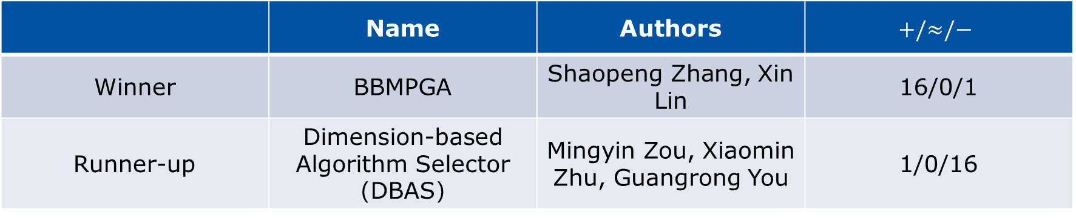
Results
 | Name | Authors | $$+/≈/−$$
Winner | BBMPGA | Shaopeng Zhang, Xin Lin | 16/0/1
Runner-up | Dimension-based Algorithm Selector（DBAS） | Mingyin Zou, Xiaomin Zhu, Guangrong You | 1/0/16
Notes:
This table shows the peak ratio results at the level of low accuracy. The number with bold font represents the corresponding algorithm achieve the best performance among the compared algorithms. It can be seen that the second algorithm obtains the most best performance.

Slide 22
THANK YOU
Notes:
That is all contents of our competition. Thank you for your listening.

